Slide 1

Emotional Intelligence

Slide 2
Objectives
Terminal Objective
Participants will become familiar with EQ theory and how their leadership style relates to EQ.
Enabling Objectives
State the definition of Emotional Intelligence.
Explain why “EQ” is important at Phillips and today’s business world.
Develop knowledge on how to manage EQ when interacting with others.

Slide 3

Activity
Best & Worst
Boss
Notes:
Break participants into two groups.
One group will list the traits of the best boss they have had.
The other group will list the traits of the worst boss they have had.
After the given time, they will come back together and read out what they discussed in their groups.
Each group will need to whiteboard this exercise.

Slide 4

What is emotional intelligence?
“Your ability to recognize and understand emotions, and your skill at using this awareness to manage yourself and your relationships with others.”
Self-Awareness
Self-Management
Social Awareness
Social Management
~ Dr. Travis Bradberry and Jean Greaves
The Emotional Intelligence Quickbook
Notes:
In a different way, Daniel Goleman defined it as:
A set of abilities such as being able to motivate oneself and persist in the face of frustrations; to control impulses and delay gratification; to regulate one’s moods and keep distress from swamping the ability to think; to emphasize and to hope.
It gives a person a set of perspectives and behaviors that allows you to navigate your way through the complex world of emotions and interpersonal challenges.
The term, “Emotional Intelligence,” was first created in 1990 by two psychologists, John Meyer of the University of New Hampshire and Peter Salovey of Yale. They identified four building blocks to developing EQ competence:
The ability to accurately perceive, appraise and express emotion.
The ability to access or generate feelings on demand when they can facilitate understanding
of yourself or another person.
The ability to understand emotions and the knowledge that derives from them.
The ability to regulate emotions to promote emotional and intellectual growth.
You experience EQ everyday:
Challenges at work getting a long with a peer
Needing to sell an idea at work and get people on board with it
Soothing a tense situation or calming a person in distress
Conflict with a teenager
Getting cut off on the way to work
EI vs EQ – EI = the capacity, EQ = the measure of capacity
What emotional intelligence is not:
Aptitude -- A written, oral, or performance test designed to measure a person’s potential ability for performing well in some future selected skill or activity (i.e. musical aptitude)
Achievement -- A standardized examination that assesses the proficiency level already attained in specific performance (i.e. school grades, SAT scores).
Vocational Interest – An assessment of a person’s interests in order to help them choose, prepare for, enter upon, and progress in an occupation
Personality – A distinctively different characteristic or sum total of a person, including his or her behavior and character traits (honesty, loyalty, introversion)

Slide 5
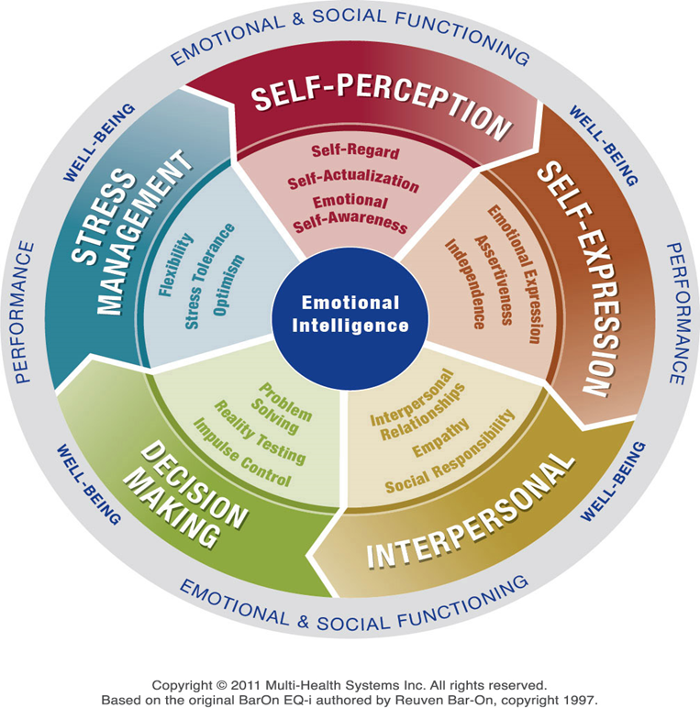
The EQ-i 2.0 Model
Notes:
Model of Emotional Intelligence 5 parts:
Self-Perception – self-regard, self-actualization, emotional awareness
Self-Expression – emotional expression, assertiveness, independence
Interpersonal – interpersonal relationships, empathy, social responsibility
Decision Making – problem solving, reality testing, impulse control
Stress Management – flexibility, stress tolerance, optimism
As we discuss each area in detail, that section of the ‘pie” will be enlarged.

Slide 6
Self-Perception
Emotional
Self-Awareness
Self-
Actualization
Self-Regard
Notes:
If you aren’t aware of what you are doing, why you are doing it, and the way its affecting others, you can’t change.
Emotional self-awareness
Accurately recognizes emotions as they happen and understands general tendencies for responding to different people and situations
Is mindful of what is happening inside the brain
Is attuned to guiding values – can see big picture in complex situation
Is attuned to inner signals -- knows how feelings affect behavior and job performance
Is able to speak openly or with conviction about guiding vision
Self–regard
Has ability to respect and accept self
Doesn’t set the bar so high that can’t achieve goals of performance
Doesn’t engage in negative self-talk
Knows that people fail from overconfidence
Self Actualization
Has ability to realize potential capacities
Is pleased with position in life with respect to personal, occupational and financial goals
Knows limitations and strengths
Exhibits a sense of humor, grace in learning where to improve
Welcomes constructive criticism and feedback
Knows when to ask for help and where to focus in developing leadership strengths

Slide 7
Self-Expression
Emotional
Expression
Independence
Assertiveness
Notes:
Emotional Expression
Involves openly expressing feelings both verbally and non-verbally
Uses awareness of emotions to choose what is said and done --- this positively directs behavior
Thinks about the message sent when looking at phone while talking to someone
Independence
Has ability to be self directed and self controlled in thinking and actions
Is free from emotional dependency
Takes charge of life and controls own destiny
Seize or creates opportunities
Cuts through red tape, bends rules when required
Has high personal standards that seek performance improvements
Is pragmatic, sets measurable goals, calculates risk, continually learns and teaches ways to do better
Assertiveness
Has ability to express feelings, beliefs and thoughts openly, while standing up for personal rights
Lives values (remember those values you developed under Self-awareness?)
Has an authentic openness to others about feelings, beliefs, and actions – allows integrity
Admits openly mistakes or faults, confronts unethical behavior in others
Is incapable of being passive

Slide 8
Self Awareness Activity
Emotional Awareness: What emotions do I feel most often at work?
  (e.g., excitement, frustration, pride, anxiety)
Triggers: What situations or people tend to trigger strong emotional reactions in me?
Impact: How do my emotions affect my behavior and relationships at work?
Awareness Gaps: When am I least aware of my emotions?
Strengths: How does being aware of my emotions help me lead, communicate, or make decisions?

Slide 10

Interpersonal
Social
Responsibility
Relationships
Empathy
Notes:
Interpersonal Relationships
Having the ability to establish and maintain mutually satisfying exchanges that are ‘give’ and ‘take’ where trust and compassion are openly expressed in words
Can generate atmosphere of friendly collegiality that are models of respect, helpfulness and cooperation
Draws others into active, enthusiastic commitment to the collective effort and builds spirit and identity
Spends time forging and cementing close relationships beyond mere work
Monitors worker satisfaction carefully to ensure each person gets what he needs
Makes herself available
Is politically astute, able to detect crucial social networks and read key power relationships
Is able to understand the political forces at work in the organization as well as the guiding values and unspoken rules that operate in the group
Empathy
Has ability to be aware of, understand, and appreciate the feelings and thoughts of others
Has ability to attune to a wide range of emotional signals
Can sense the felt but unspoken emotions of a person or group
Listens attentively and can grasp the another person’s perspective
Gets along well with people from diverse backgrounds or from other cultures
Social Responsibility
Has willingness to contribute to society, social group and welfare of others
Acting in a responsible manner even if it doesn’t benefit you personally.
Upholds social rules;
Acts IAW your conscience

Slide 11
When you hear the word empathy, what comes to mind?
Empathy

Slide 12
Empathy Discussion
What empathy is:
What empathy is not:
Listening to understand
Acknowledging feelings
Curious and calm
Connecting
Fixing or solving immediately
Telling someone they shouldn’t feel that way
Judgmental or dismissive
Correcting

Slide 13
Empathy Activity
Coworker: I’m totally overwhelmed. I can’t catch up.
You’ll be fine. Just work faster.
That sounds stressful. What’s making it so hard to catch up?

Slide 14
Empathy Activity
Teammate makes a mistake on a project.
You really dropped the ball.
That’s tough — I’ve been there too. What can we do to fix it?

Slide 16

Decision making
Reality Testing
Problem Solving
Impulse Control
This Photo by Unknown Author is licensed under CC BY
Notes:
Reality testing
Has ability to be objective and authenticate ideas and thoughts
Maintains a focus on the outside world , never burying head in the sand
Doesn’t make a mountain out of a molehill
Is quick to recognize where problems exists and, also, where opportunities exist
Problem solving
Has ability to find solutions to problems and to avoid emotions interfering with quality decision making
Is disciplined
Comes with a solution instead of handing over another problem
Brings innovation and intuition to the situation
Impulse control – THE HARDEST OF THE 15 to CHANGE
Has the ability to resist or delay an impulse or temptation to act
Manages disturbing emotions and impulses or channels them in useful ways
Stays calm and clear-headed under stress or during a crisis
Remains unflappable in trying situations – maintains accountability
Avoids being hostile, aggressive, angry or irresponsible

Slide 17
Impulse Control
“When someone pushes your buttons — what’s your natural reaction?”

Slide 18
Impulse Control
Impulse control is the ability to pause and think before acting or speaking.
It’s not about suppressing emotion — it’s about managing the space between stimulus and response.

Slide 19
Impulse Control
Trigger → Pause → Choice → Outcome

Slide 20
Impulse Control - Activity
Someone posts something about work on social media that makes you look bad.
What’s the trigger?
What’s the impulse reaction that most people might do?
What’s the controlled response?

Slide 22

Stress Management
Flexibility
Stress Tolerance
Optimism
Notes:
Flexibility
Has ability to adjust emotions, thoughts and behavior to changing conditions and situations
Recognizes need for change, challenges the status quo, and champions a new order
Has strong change advocates in the face of opposition, makes compelling arguments
Finds practical ways to overcome barriers (adapt and overcome)
Knows that flexible people are agile, synergistic, and capable of reacting soundly to change
Can juggle multiple demands without losing focus or energy
Is comfortable with ambiguities of the organization and is flexible in adapting to new challenges
Stress tolerance
Has the ability to withstand adverse events without developing physical or emotional symptoms
Choose action to deal with stress
Manages disturbing emotions and impulses then channels them in useful ways
Stays calm and clear-headed under stress or during a crisis while maintaining accountability (during plant events, I learned to put my hands in my pockets and take a few breaths before doing anything – forced a quick relax)
Optimism
Look at the brighter side of life and maintain a positive outlook, remaining hopeful and resilient.
Rolls with the punches, sees opportunities instead of threats.
Sees others positively, expects the best of people, positive outlook enables them to expect future changes will be for the better.

Slide 23
Stress Tolerance
“What happens when pressure builds up — physically or mentally — for you?”

Slide 24
Stress Tolerance
Stress tolerance is the ability to stay calm, think clearly, and keep functioning effectively — even when things get tough.

Slide 25
Stress Tolerance
Pressure → Awareness → Strategy → Control
“It’s not about eliminating stress — it’s about managing your response to it.”

Slide 26
Stress Tolerance - Activity
You’re juggling three urgent deadlines, and your boss adds a fourth project — all marked “top priority.”

Slide 27
Stress Tolerance - Activity
What is the main stressor?
What is a typical (unhealthy) reaction?
What is a healthier reaction?

Slide 28

Questions

