Slide 1
East Tennessee Chapter
Monthly Chapter Meeting
Thursday, August 22, 2024

Slide 2
Meeting Agenda
Welcome
Congratulations
Introductions – 2024 Board
Announcements – education calendar
ASSP Mission, Vision, and Values
Old Business
Presentation
New Business
Meeting Adjournment

Slide 3
Welcome!

Slide 4
Congratulations!
David Hixenbaugh
On being elected South Area Director for Region VII!
Melissa McKenzie
On being awarded the President’s Award at Safety24

Slide 5
Introductions – Board and Committees
President: Ann Schubert (541) 979-2912
President-Elect: Accepting nominations for 2025
Secretary: Mel McKenzie (865) 603-4846
Treasurer: Kris Thomasson (865) 207-2393
Communications Chair: Rich Heinzenberger (865) 693-3623
Membership Chair: Lee McCord (865) 368-9282
Programs Chair: Floyd Yount (423) 470-6946
Nominations and Elections Chair: Lance Greene (865) 809-5003
Professional Development Conference Chair: Jay Hocutt (865) 771-9495
Advisory Group Member: Donald Elswick (419) 788-6162
Awards & Honors Chair: Bethany Knight (859)583-2606
Jobs Chair: Jeff Headrick (

Slide 6
Announcements – Education Calendar
ASSP Educational Events Calendar
ASSP/TVS-AIHA Professional Development Conference (PDC)
11/6-11/7 – The Venue, Lenoir City
Region VI will be hosting a PDC - Virginia Beach
September 18 – 20th (Wednesday – Friday)
SafetyFOCUS
October 21-25 – Virtual
February 2025 – In person, Las Vegas, NV
Notes:
Show Education Calendar
ASSP Educational Events Calendar

Slide 7
ASSP Mission, Vision & Values
Our Mission: We are the community that protects people, property and the environment.
Our Vision: Safety, health and well-being are inherent rights of every worker.
Our Values: Our CLEAR values guide our behavior, decisions and actions.
Community: We provide a welcoming and collaborative environment that creates belonging and inclusivity for all.
Leadership: We exemplify integrity and empower others.
Excellence: We strive always to deliver our best.
Accountability: We are ethical, reliable and trustworthy in all we do.
Respect: We act with humility, listen to others and foster strong working relationships
Notes:
ASSP Video - Clear Values

Slide 8
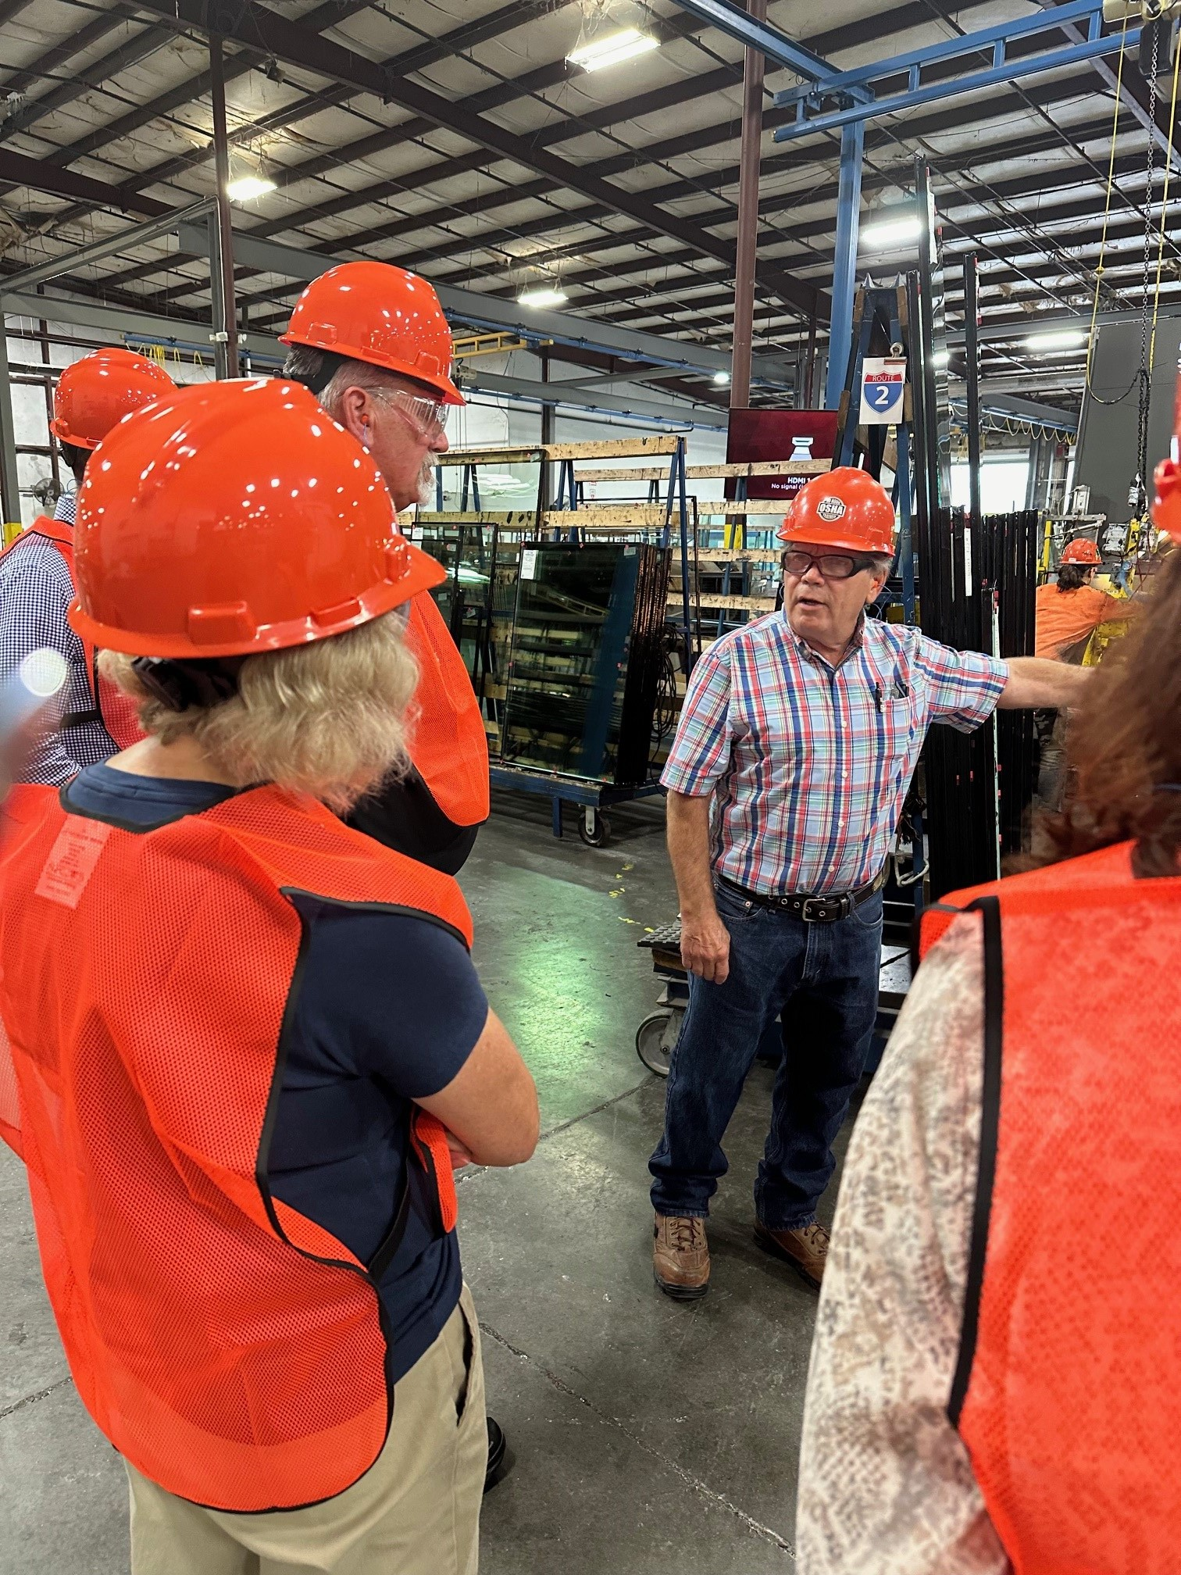
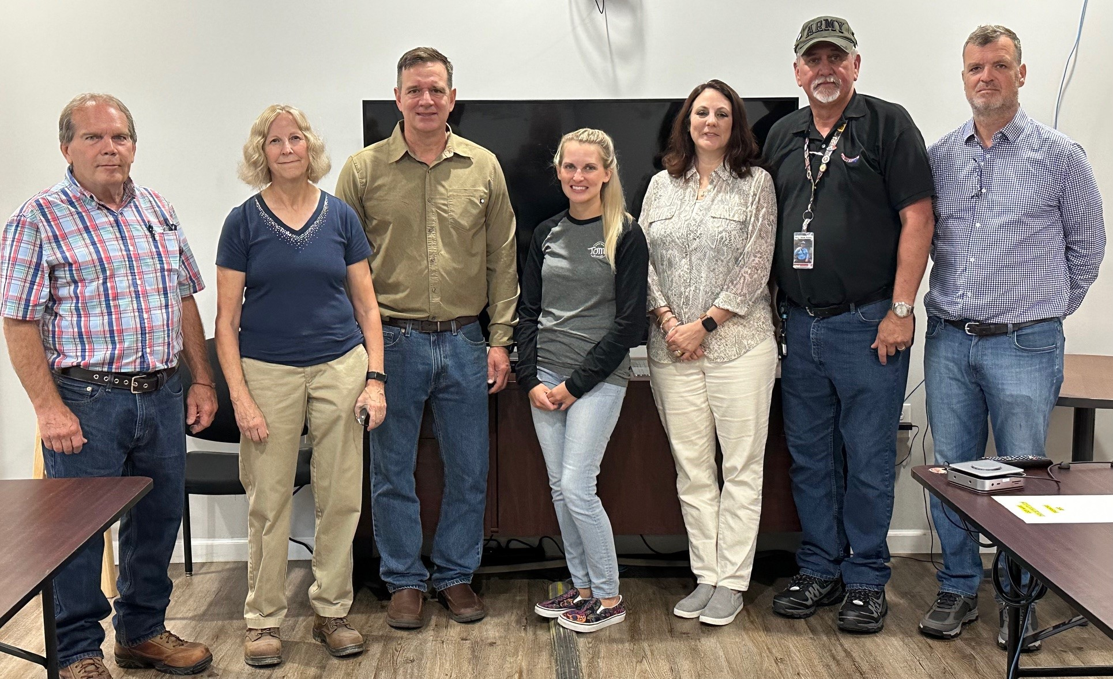
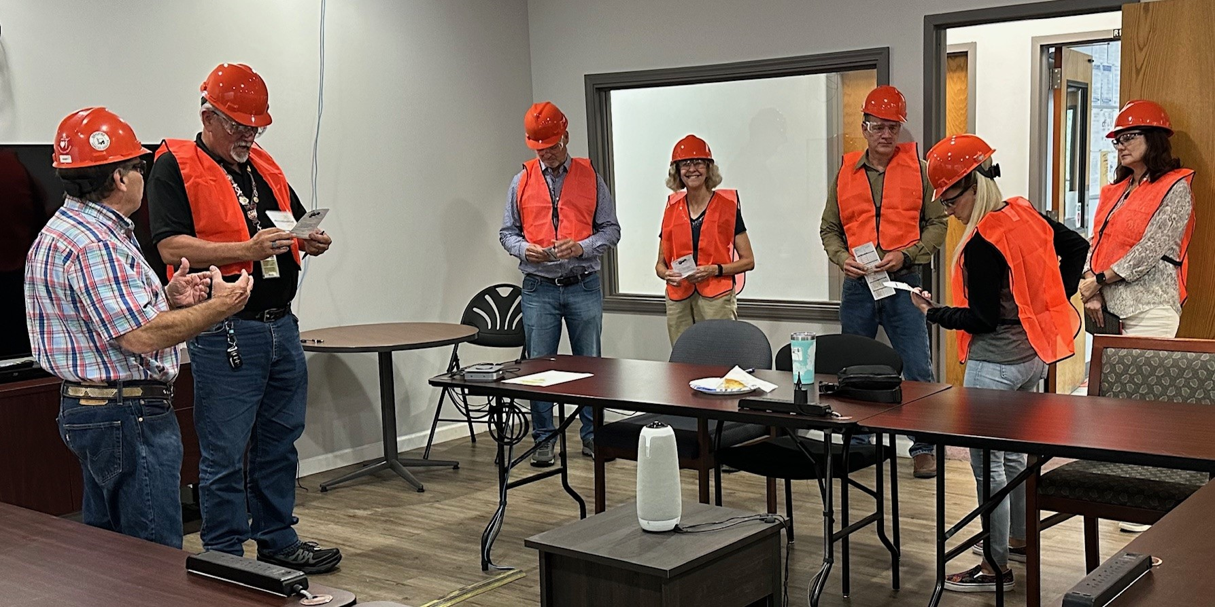
July Tour of Trulite
Thank you, Robby Stroud!
Notes:
ASSP Video - Clear Values

Slide 9
Old Business

Slide 10
Old Business
August Secretary’s Report
July meeting minutes emailed out 08/20/2024.
August Treasure’s Report
Revenue (from Chapter Dues) = $390.55
Expenses = $584.55
Current Balance = $30,963.68

Slide 11
Other Old Business
Member Survey Winner – Cheryl Smith
Annual Planning Report submitted (List of goals)
Fall ROC – Columbus, OH
September 12 & 13
Offering CEUs for Meetings

Slide 12
Region IV VPPPA
Guest Speaker: Jay Hocutt, CSP, SGE, STS
Meeting Day: Thursday, August 22, 2024
Location: Phillips & Jordan
10142 Parkside Drive, Suite 500, Knoxville, TN
Virtual Option: Join the meeting now
Meeting ID: 215 829 201 074
Passcode: VsYNbP
Time: 3:00 PM to 4:00 PM EST

Slide 13
Region IV VPPPA Volunteer Protection Participation Program Association
Jay Hocutt CSP, SGE, STS
Director-at-Large Region IV

Slide 14
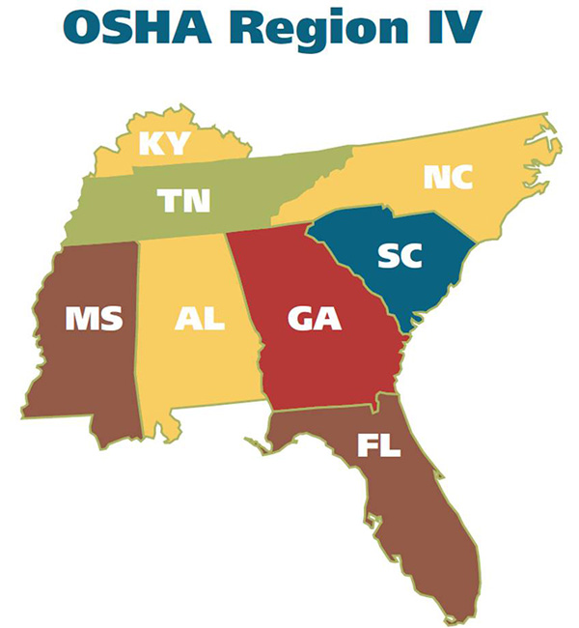
State plans
Kentucky
Tennessee
North Carolina
South Carolina
Federal Plans
Mississippi
Alabama
Georgia
Florida
Phil Walsh - Chairperson
Global EHS Director
Americhem, Inc
Tupelo, MS
Phone: (662) 321-8234
Email: phil.walsh@americhem.com

Slide 15
What is VPP?
The Voluntary Protection Program is designed to encourage cooperative efforts between employees, management and OSHA for the purpose of improving workplace safety and health.
The VPP concept recognizes that workplace safety and health can be enforced in a compliance atmosphere and can be enhanced in a cooperative atmosphere.
OSHA recognizes and partners with work sites that demonstrate excellence in Safety and Health.

Slide 16
Tennessee State Plan
On average the Tennessee Volunteer STAR sites experience three-year Total Case Incident Rates (TCIR) 69.4% below their industry average and three-year Days Away, Restricted or Transferred Case Rates (DART) 72.1% below their industry average.
David Blessman
STAR Program Manager
(615) 253-6890
David.Blessman@tn.gov
Volunteer STAR (tn.gov)

Slide 17
Benefits of the Volunteer STAR program
Improved employee motivation to work safely, leading to better quality and productivity
Reduced workers' compensation costs
Recognition in the community
Improvement of programs that are already good, through the internal and external review that's part of the Volunteer STAR application process
Volunteer STAR participant sites generally experience from 60 to 80 percent fewer lost workday injuries than would be expected of an "average" site of the same size in their industries

Slide 18
How does VPP work?
Management and employees, including organized labor, agree to participate in the process.
Then TN OSHA makes a voluntary site visit to confirm the worksite qualifies for Volunteer Star recognition.
The site is then recognized as a Star participant
Follow-up visits from TN OSHA (usually at three to five-year intervals) to ensure continued high safety standards and safe practices.

Slide 19
How to become a Volunteer Star Site
Do I qualify?
Injury and Illness rates below industry standards for the past 3 years (avg.)
Safety and Health Program review
Management Leadership and Employee Involvement
Worksite Analysis
Hazard Prevention and Control
Safety and Health Training
Union written commitment

Slide 20
Up Coming Conference
We look forward seeing everyone in 2025 at the Evergreen Lake Resort in Stone Mountain, GA.
The 2025 Safety & Health Conference will be May 4-6, 2025.

Slide 21
Volunteer Protection Programs Participants
Federal OSHA VPP Page
Voluntary Protection Program Participants Association
Region IV Voluntary Protection Program

Slide 22
Questions
Jay W. Hocutt CSP, SGE, STS
Region IV Director at Large
865-771-9495
Jay.Hocutt@orcc.doe.gov
David Blessman
STAR Program Manager
(615) 253-6890
David.Blessman@tn.gov

Slide 23
New Business

Slide 24
New Business
East Tennessee State University – Working to get students from their Safety Program involved in the Chapter.
TVS-AIHA Professional Development Conference (PDC) is looking for speakers. Submit abstract and bio to:
Mark Houston, CIH, CSP, CHMM
TVS-AIHA President Elect
houstonmm@ornl.gov
505-944-6730

Slide 25
Upcoming Meetings

Slide 26
Upcoming Meetings
Upcoming Meetings:
September Chapter Meeting TBD
Ethics (planned)
September 9 – EHS Morristown Lunch Mtg
October TBD
Denso Tour
Please see chapter website for any updates

Slide 27
Meeting Adjournment

Slide 28
Thank You!
Thank you for joining us today!
Please reach out to any of the board members if you have questions or need additional information.

