Slide 1
East Tennessee Chapter
Monthly Chapter Meeting
Thursday, June 27, 2024

Slide 2
Meeting Agenda
Welcome
Introductions – 2024 Board
Announcements – education calendar
ASSP Mission, Vision, and Values
Old Business
Presentation
New Business
Meeting Adjournment

Slide 3
Welcome!

Slide 4
Introductions – Board and Committees
President: David Hixenbaugh (865) 603-4556
President-Elect: Ann Schubert (541) 979-2912
Secretary: Mel McKenzie (865) 603-4846
Treasurer: Kris Thomasson (865) 207-2393
Communications Chair: Rich Heinzenberger (865) 693-3623
Membership Chair: Lee McCord (865) 368-9282
Programs Chair: Floyd Yount (423) 470-6946
Nominations and Elections Chair: Lance Greene (865) 809-5003
Professional Development Conference Chair: Jay Hocutt (865) 771-9495
Advisory Group Member: Donald Elswick (419) 788-6162
Awards & Honors Chair: Bethany Knight
Jobs Chair: Jeff Headrick

Slide 5
Announcements – Education Calendar
ASSP Educational Events Calendar
Safety 2024 Conference & Expo – Denver, Colorado
8/6 Leadership Conference please consider attending!
8/7 – 8/9: 1.50 CEU
ASSP/TVS-AIHA Professional Development Conference (PDC)
11/6-11/7 – The Venue, Lenoir City
Region VI will be hosting a PDC - Virginia Beach
September 18 – 20th (Wednesday – Friday)
Notes:
Show Education Calendar
ASSP Educational Events Calendar

Slide 6
ASSP Mission, Vision & Values
Our Mission: We are the community that protects people, property and the environment.
Our Vision: Safety, health and well-being are inherent rights of every worker.
Our Values: Our CLEAR values guide our behavior, decisions and actions.
Community: We provide a welcoming and collaborative environment that creates belonging and inclusivity for all.
Leadership: We exemplify integrity and empower others.
Excellence: We strive always to deliver our best.
Accountability: We are ethical, reliable and trustworthy in all we do.
Respect: We act with humility, listen to others and foster strong working relationships
ASSP Video - Clear Values
Notes:
Show Education Calendar
ASSP Educational Events Calendar

Slide 7
Old Business

Slide 8
Old Business
June Secretary’s Report
May meeting minutes emailed out 06/05/2024.
June Treasure’s Report
Revenue (from Chapter Dues) =
Expenses =
Current Balance =
March Meeting Minute approval
March minutes emailed out 3/27/2024
Other old business?

Slide 9
Other Old Business
Member Survey Winner
June 30, end of year – final chapter report due
Fall ROC – Columbus, OH
September
Offering CEUs for Meetings

Slide 10
Heat-Related Wearable Technology
Guest Speaker: Ryan Cannady, CIH, CSP, STS-C
Meeting Day: Thursday, June 27, 2024
Location: UCOR Meet & Train
701 Scarboro Road, Oak Ridge, TN
Virtual Option: Join the meeting now
Meeting ID: 210 027 615 055
Passcode: 8cEic6
Time: 2:00 PM to 3:30 PM EST

Slide 11
Heat Cost and Productivity Impacts
How much does a heat incident cost?
Medical costs increase _____ per degree Celsius when the temperature exceeds 33°C (91.4°F).
Productivity of workers declines approximately _____ per degree Celsius above a Wet Bulb Globe Temperature (WBGT) of 24°C (75.2°F).
41.6%
2.6%

Slide 12
Seasonal Outlook
NOAA declared 2023 was the warmest year on record, by far
2024 continues to shows significant climate anomalies and events
April 2024 was the Earth’s warmest year on record

Slide 13
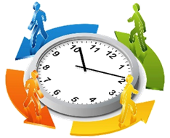
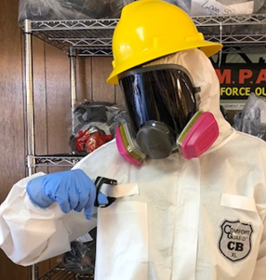
Heat Tolerance
Activity
Personal conditions
Heat Stress Risk
Environmental conditions
Clothing/PPE

Slide 14
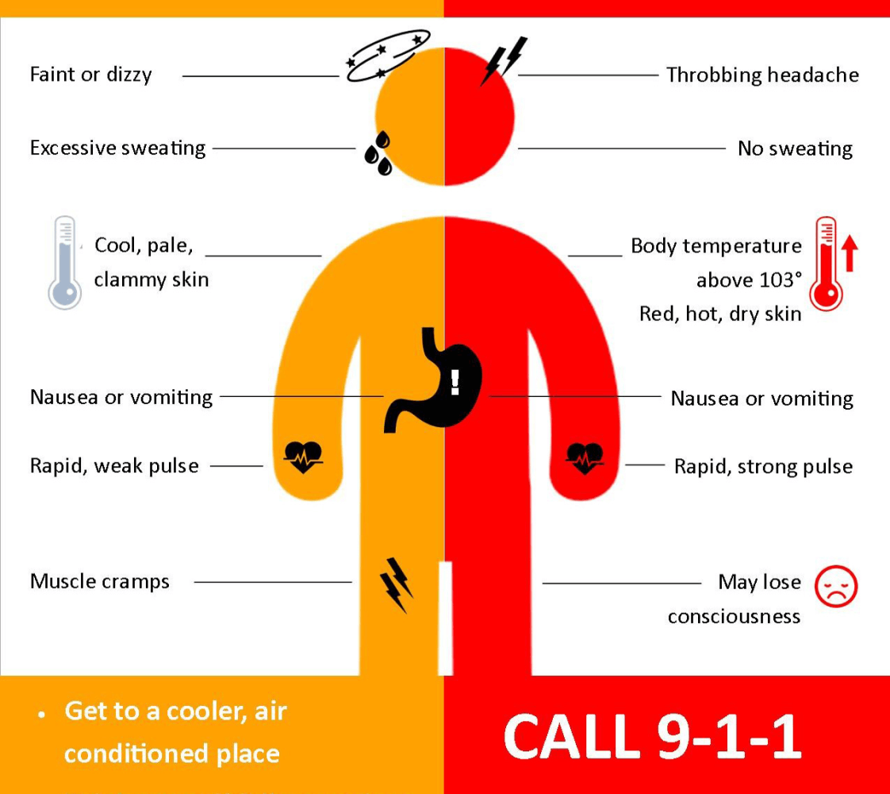
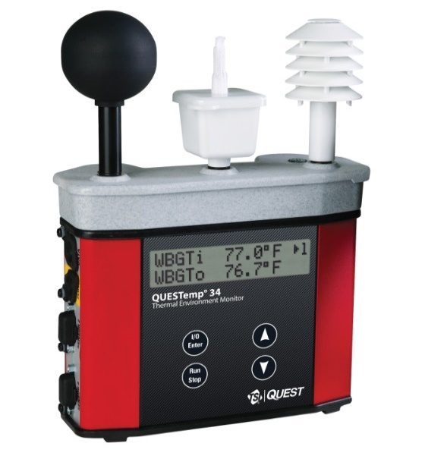
Understanding Heat Stress and Strain
Heat Stress
Heat Strain

Slide 15
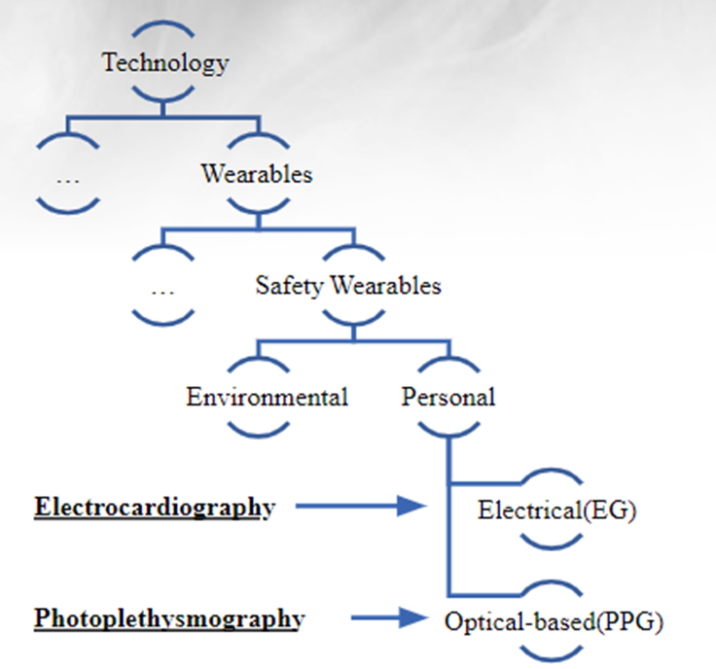
Heat-Related Technologies
Notes:
EG- electrical activity of the heart over time
PPG- green light waves that hemoglobin absorbs. As heart beats and blood volume changes under the skin, the amount of light absorbed fluctuates.

Slide 16
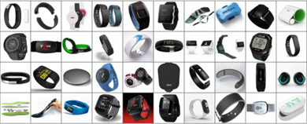
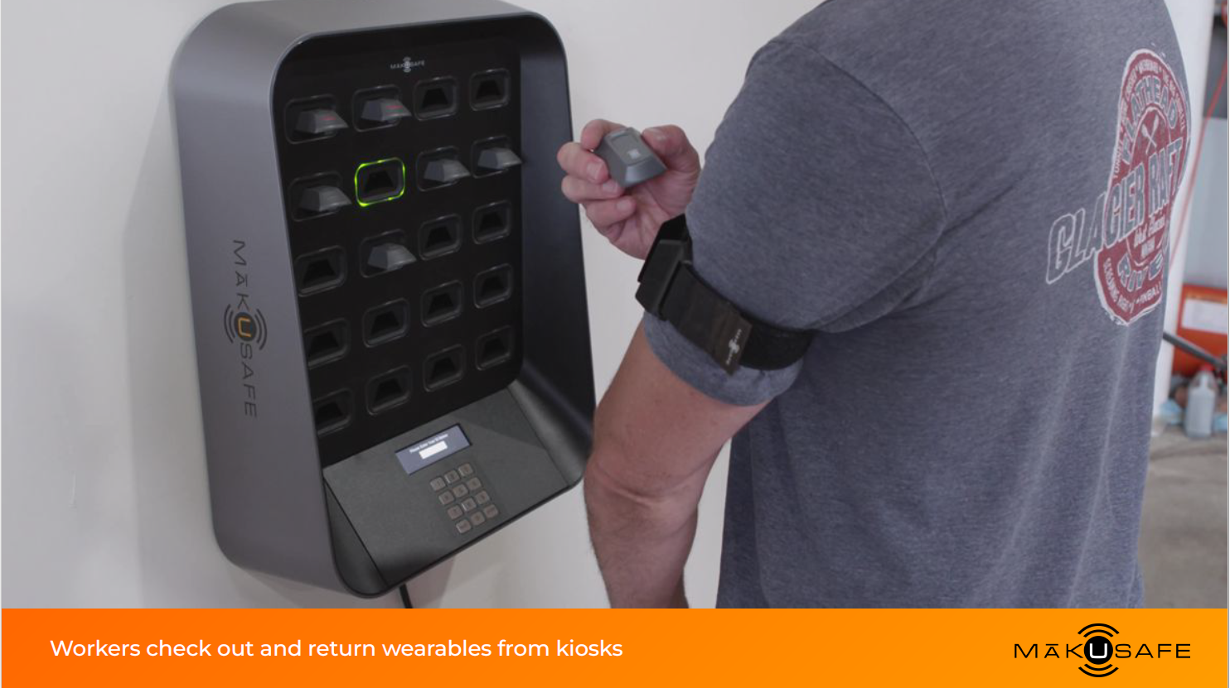
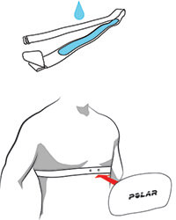
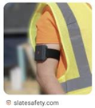
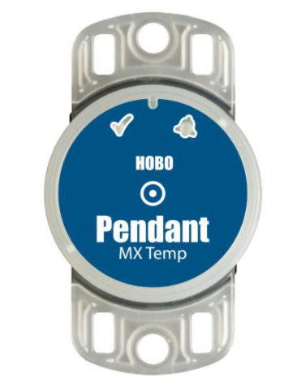
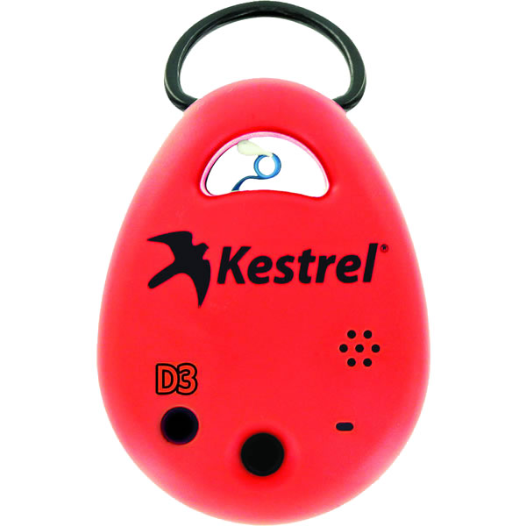
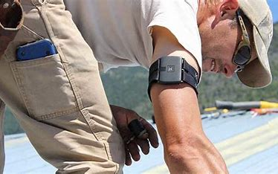
Wearable Technologies
Physiological monitoring
Environmental monitoring

Slide 17
Benefits and Limitations of Wearable Technology
Physiological Monitoring Pros
Individual focus
Real-time
Non-invasive estimations
Environmental Monitoring Pros
Work area specific
Machine learning to anticipate risk
Various environmental conditions (noise, air quality, light, etc.)
Physiological Monitoring Cons
Limited field validation
Intensive support
Data interpretation
Minimal strategies to effectively implement
Environmental Monitoring Cons
Solar load/radiant heat

Slide 18
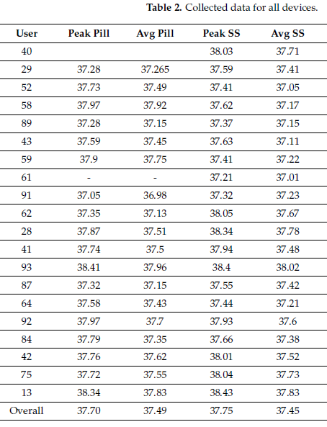
Physiological Monitoring Limitations
Max Temperature:
38.41C ➔ 101.1F

Slide 19
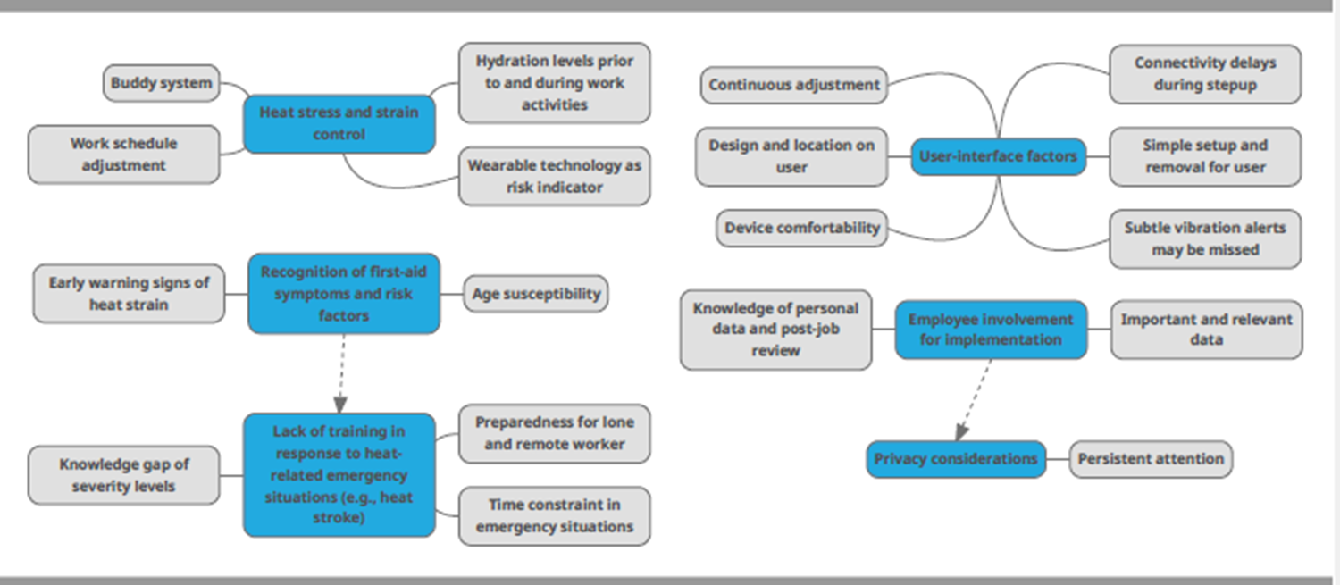
Pilot Project Evaluating at Wearable Technologies
Farmworkers (6 male) wore two devices throughout a standard workweek
Carpenter (2), electrician, landscaper, husbandry worker, heavy equipment operator
Cow/Calf Production
Facilities Management
MākuSafe armband
SlateSafety V2 armband

Slide 20
In Summary
Wearable technology provides real-time, individual, and work-specific data.
Workers seem to appreciate when employers consider their individual health.
Future work needs to validate the algorithms in occupational settings.

Slide 21
Questions

Slide 22
New Business

Slide 23
Any New Business?

Slide 24
Upcoming Meetings

Slide 25
Upcoming Meetings
Upcoming Meetings:
July 25, 2024 – 8:00-10:00AM
Trulite Glass
August 22, 2024 – 3:00-4:00PM
Phillips & Jordan
Please see chapter website for any updates
Meeting Adjournment

Slide 26
Thank You!
Thank you for joining us today!
Please reach out to any of the board members if you have questions or need additional information.

